Slide 1



Chapter 3
The Interaction

Slide 2
The Interaction
Interaction models
Translations between user and system
Ergonomics
Physical characteristics of the interaction and its effectiveness.
Interaction styles
The nature of user/system dialog
Context
Social, organizational, motivational

Slide 3
What is interaction?
communication
user system
but is that all … ?
see “language and action” in chapter 4 …

Slide 4
Models Of Interaction
Terms Of Interaction
Norman Model
Interaction Framework

Slide 5
Some Terms Of Interaction
domain– the area of work under study
e.g. graphic design
goal – the desired output from a performed task or
what you want to achieve
e.g. create a solid red triangle
task – how you go about doing it – ultimately in terms of operations or actions
e.g. … select fill tool, click over triangle
Note …
traditional interaction …
use of terms differs a lot especially task/goal !!!

Slide 6
Some Terms Of Interaction (cont.)
Task analysis involves the identification of the problem space for the user of an interactive system in terms of the domain, goals, intentions and tasks.
We can use our knowledge of tasks and goals to assess the interactive system that is designed to support them.
The concepts used in the design of the system and the description of the user are separate, and so we can refer to them as distinct components, called the System and the User, respectively.

Slide 7
Some Terms Of Interaction (cont.)
The System and User are each described by means of a language that can express concepts relevant in the domain of the application.
The System’s language we will refer to as the core language and the User’s language we will refer to as the task language.
The core language describes computational attributes of the domain relevant to the System state, whereas the task language describes psychological attributes of the domain relevant to the User state.

Slide 8
Donald Norman’s model
Seven stages
User establishes the goal
Formulates intention
Specifies actions at interface
Executes action
Perceives system state
Interprets system state
Evaluates system state with respect to goal
Norman’s model concentrates on user’s view of the interface.

Slide 9
The interactive cycle: execution-evaluation loop
goal
user establishes the goal
formulates intention
specifies actions at interface
executes action
perceives system state
interprets system state
evaluates system state with respect to goal
execution
evaluation
system

Slide 10
execution/evaluation loop
goal
user establishes the goal
formulates intention
specifies actions at interface
executes action
perceives system state
interprets system state
evaluates system state with respect to goal
execution
evaluation
system

Slide 11
execution/evaluation loop
goal
user establishes the goal
formulates intention
specifies actions at interface
executes action
perceives system state
interprets system state
evaluates system state with respect to goal
execution
evaluation
system

Slide 12
execution/evaluation loop
goal
user establishes the goal
formulates intention
specifies actions at interface
executes action
perceives system state
interprets system state
evaluates system state with respect to goal
execution
evaluation
system

Slide 13
Example of Norman cycle: switching on a light
Imagine you are sitting reading as evening falls. You decide you need more light; that is you establish the goal to get more light. From there you form an intention to switch on the desk lamp, and you specify the actions required, to reach over and press the lamp switch. If someone else is closer the intention may be different – you may ask them to switch on the light for you. Your goal is the same but the intention and actions are different. When you have executed the action you perceive the result, either the light is on or it isn’t and you interpret this, based on your knowledge of the world.

Slide 14
Example of Norman cycle: switching on a light (cont.)
For example, if the light does not come on you may interpret this as indicating the bulb has blown or the lamp is not plugged into the mains, and you will formulate new goals to deal with this. If the light does come on, you will evaluate the new state according to the original goals – is there now enough light? If so, the cycle is complete. If not, you may formulate a new intention to switch on the main ceiling light as well.

Slide 15
Using Norman’s model
Some systems are harder to use than others
Gulf of Execution
user’s formulation of actions to reach the goal ≠ actions allowed by the system
If the actions allowed by the system correspond to those intended by the user, the interaction will be effective.
The interface should therefore aim to reduce this gulf.
Gulf of Evaluation
user’s expectation of changed system state ≠ actual presentation of this state
The gulf of evaluation is the distance between the physical presentation of the system state and the expectation of the user.
If the user can readily evaluate the presentation in terms of his goal, the gulf of evaluation is small.

Slide 16

Human error - slips and mistakes
slip
understand system and goal
correct formulation of action
incorrect action
mistake
may not even have right goal!
Fixing things?
slip – better interface design
mistake – better understanding of system

Slide 17
The interaction framework
Extension of Norman…
The interaction framework has 4 parts
user
input
system
output
Each component has its own language.
In addition to the User’s task language and the System’s core language, there are languages for both the Input and Output components.
Input and Output together form the Interface.
O
output
S
core
U
task
I
input

Slide 18
The interaction framework (cont.)
Since the interface sits between the User and the System, there are four steps in the interactive cycle, each corresponding to a translation from one component to another.
The User begins the interactive cycle with the formulation of a goal and a task to achieve that goal.
The only way the user can manipulate the machine is through the Input, and so the task must be articulated within the input language.
The input language is translated into the core language as operations to be performed by the System.

Slide 19
The interaction framework (cont.)
The System then transforms itself as described by the operations; the execution phase of the cycle is complete and the evaluation phase now begins.
The System is in a new state, which must now be communicated to the User.
The current values of system attributes are rendered as concepts or features of the Output.
It is then up to the User to observe the Output and assess the results of the interaction relative to the original goal, ending the evaluation phase and, hence, the interactive cycle.
There are four main translations involved in the interaction: articulation, performance, presentation and observation.

Slide 20
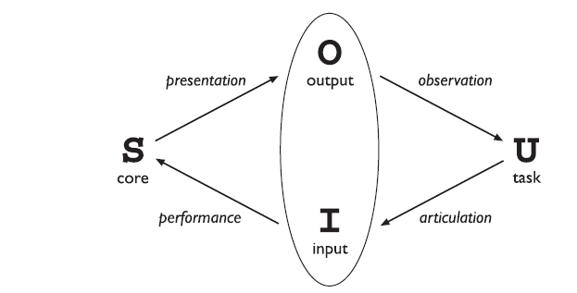
The interaction framework (cont.)
The tasks are responses of the User and they need to be translated to stimuli for the Input.
This articulation is judged in terms of the coverage from tasks to input and the relative ease with which the translation can be accomplished.

Slide 21
The interaction framework (cont.)
At the next stage, the responses of the Input are translated to stimuli for the System.
Once a state transition has occurred within the System, the execution phase of the interaction is complete and the evaluation phase begins.
The new state of the System must be communicated to the User, and this begins by translating the System responses to the transition into stimuli for the Output component.
Ultimately, the user must interpret the output to evaluate what has happened. The response from the Output is translated to stimuli for the User which trigger assessment.

Slide 22
The interaction framework (cont.)
Example: Developing a website using a markup language like HTML would be virtually impossible without being able to preview the output through a browser.
Task: Map the above mentioned scenario with respect to interaction framework.
Why do we choose to use the best editor?

Slide 23
Ergonomics
Physical aspects of interfaces
Industrial interfaces

Slide 24
Ergonomics
Study of the physical characteristics of interaction
Also known as human factors – but this can also be used to mean much of HCI!
Ergonomics good at defining standards and guidelines for constraining the way we design certain aspects of systems

Slide 25
Ergonomics - examples
arrangement of controls and displays
The exact organization that this will suggest will depend on the
domain and the application, but possible organizations
include the following:
functional controls and displays are organized so that those that are functionally related are placed together;
sequential controls and displays are organized to reflect the order of their use in a typical interaction (this may be especially appropriate in domains where a particular task sequence is enforced, such as aviation);

Slide 26
Ergonomics – examples…
frequency controls and displays are organized according to how frequently they are used, with the most commonly used controls being the most easily accessible.
surrounding environment
e.g. seating arrangements adaptable to cope with all sizes of user
health issues
should bear in mind possible consequences of our designs on
the health and safety of users
e.g. physical position, environmental conditions (temperature, humidity), lighting, noise, time

Slide 27
Ergonomics – examples…
Physical position As we noted in the previous section, users should be able to reach all controls comfortably and see all displays. Users should not be expected to stand for long periods and, if sitting, should be provided with back support. If a particular position for a part of the body is to be adopted for long periods (for example, in typing) support should be provided to allow rest.
Temperature Although most users can adapt to slight changes in temperature without adverse effect, extremes of hot or cold will affect performance and, in excessive cases, health. Experimental studies show that performance deteriorates at high or low temperatures, with users being unable to concentrate efficiently.

Slide 28
Ergonomics – examples…
Lighting The lighting level will again depend on the work environment. However, adequate lighting should be provided to allow users to see the computer screen without discomfort or eyestrain. The light source should also be positioned to avoid glare affecting the display.
Noise Excessive noise can be harmful to health, causing the user pain, and in acute cases, loss of hearing. Noise levels should be maintained at a comfortable level in the work environment. This does not necessarily mean no noise at all. Noise can be a stimulus to users and can provide needed confirmation of system activity.

Slide 29
Ergonomics – examples…
Time The time users spend using the system should also be controlled. As we saw in the previous chapter, it has been suggested that excessive use of CRT displays can be harmful to users, particularly pregnant women.
use of colour
Colors used in the display should be as distinct as possible and the distinction should not be affected by changes in contrast.
Blue should not be used to display critical information. Red, green and yellow are colors frequently associated with stop, go and standby respectively.

Slide 30
Ergonomics – examples…
Therefore, red may be used to indicate emergency and alarms; green, normal activity; and yellow, standby and auxiliary function.
However, we should remember that color conventions are culturally determined.
For example, red is associated with danger and warnings in most western cultures, but in China it symbolizes happiness and good fortune. The color of mourning is black in some cultures and white in others.

Slide 31

Industrial interfaces
Office interface vs. industrial interface?
Context matters!
office industrial
type of data textual numeric
rate of change slow fast
environment clean dirty
… the oil soaked mouse!

Slide 32
Glass interfaces ?
industrial interface:
traditional … dials and knobs
now … screens and keypads
glass interface
cheaper, more flexible, multiple representations, precise values
not physically located, loss of context, complex interfaces
may need both
Vessel B Temp
0
100
200
113
multiple representations of same information

Slide 33
Indirect manipulation
office– direct manipulation
user interacts with artificial world
system
industrial – indirect manipulation
user interacts with real world through interface
issues ..
feedback
delays
interface
plant
immediate
feedback
instruments

Slide 34
Interaction Styles
dialogue … computer and user
distinct styles of interaction

Slide 35
Common interaction styles
command line interface
menus
natural language
question/answer and query dialogue
form-fills and spreadsheets
WIMP
point and click
three–dimensional interfaces

Slide 36
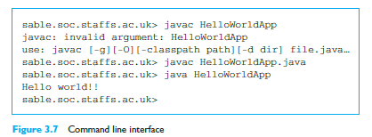
Command line interface
Way of expressing instructions to the computer directly
function keys, single characters, short abbreviations, whole words, or a combination
suitable for repetitive tasks
better for expert users than novices
offers direct access to system functionality
command names/abbreviations should be meaningful!
Typical example: the Unix system

Slide 37
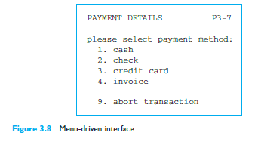
Menus
Set of options displayed on the screen
Options visible
less recall - easier to use
rely on recognition so names should be meaningful
Selection by:
numbers, letters, arrow keys, mouse
combination (e.g. mouse plus accelerators)
Often options hierarchically grouped
sensible grouping is needed
Restricted form of full WIMP system

Slide 38
Natural language
Familiar to user
speech recognition or typed natural language
Problems
vague
ambiguous
hard to do well!
Solutions
try to understand a subset
pick on key words
First, the syntax, or structure, of a phrase may not be clear. If we are given the sentence ---------
The boy hit the dog with the stick
We cannot be sure whether the boy is using the stick to hit the dog or whether the dog is holding the stick when it is hit.

Slide 39
Query interfaces
Question/answer interfaces
user led through interaction via series of questions
suitable for novice users but restricted functionality
often used in information systems
Query languages (e.g. SQL)
used to retrieve information from database
requires understanding of database structure and language syntax, hence requires some expertise

Slide 40
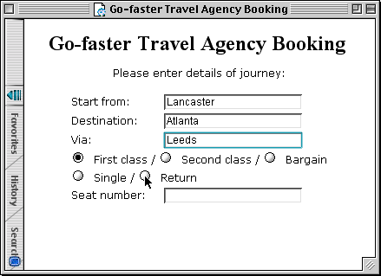
Form-fills
Primarily for data entry or data retrieval
Screen like paper form.
Data put in relevant place
Requires
good design
obvious correction facilities

Slide 41
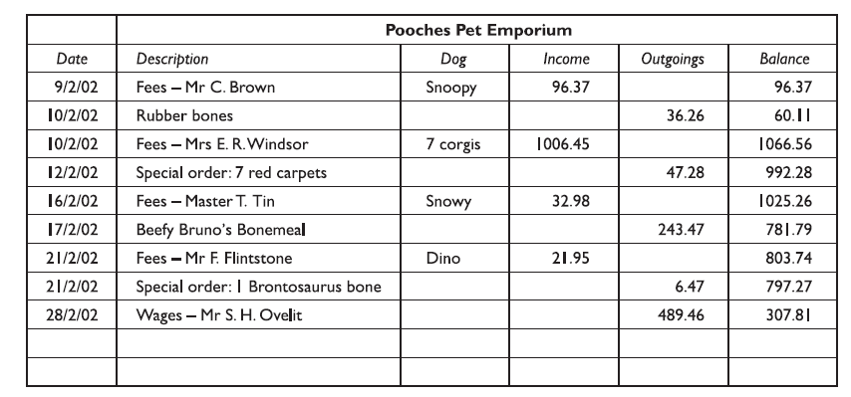
Spreadsheets
first spreadsheet VISICALC, followed by Lotus 1-2-3 MS Excel most common today
sophisticated variation of form-filling.
grid of cells contain a value or a formula
formula can involve values of other cells e.g. sum of all cells in this column
user can enter and alter data spreadsheet maintains consistency

Slide 42
WIMP Interface
Windows
Icons
Menus
Pointers
… or windows, icons, mice, and pull-down menus!
default style for majority of interactive computer systems, especially PCs and desktop machines.
Examples of WIMP interfaces include Microsoft Windows for IBM PC compatibles, MacOS for Apple Macintosh compatibles and various X Windows-based systems for UNIX.

Slide 43
Point and click interfaces
used in ..
multimedia
web browsers
hypertext
just click something!
icons, text links or location on map
minimal typing

Slide 44


Three dimensional interfaces
virtual reality
‘ordinary’ window systems
highlighting
visual affordance
indiscriminate use just confusing!
3D workspaces
use for extra virtual space
light and occlusion give depth
distance effects
flat buttons …
click me!
… or sculptured

Slide 45
Elements Of The Wimp Interface
windows, icons, menus, pointers
+++
buttons, toolbars, palettes, dialog boxes
also see supplementary material on choosing wimp elements

Slide 46
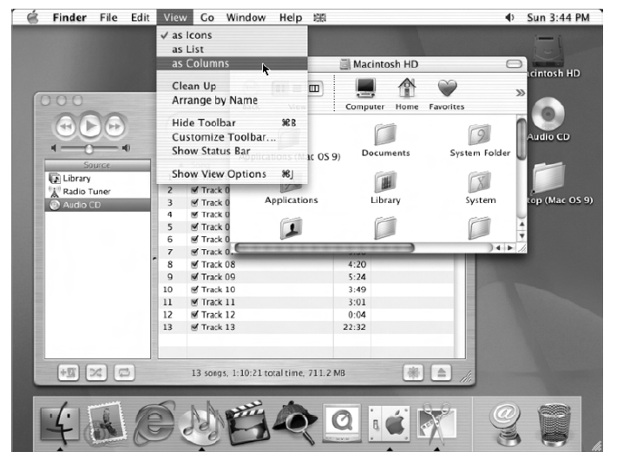
Windows
Areas of the screen that behave as if they were independent
can contain text or graphics
can be moved or resized
can overlap and obscure each other, or can be laid out next to one another (tiled)
scrollbars
allow the user to move the contents of the window up and down or from side to side
title bars
describe the name of the window

Slide 47
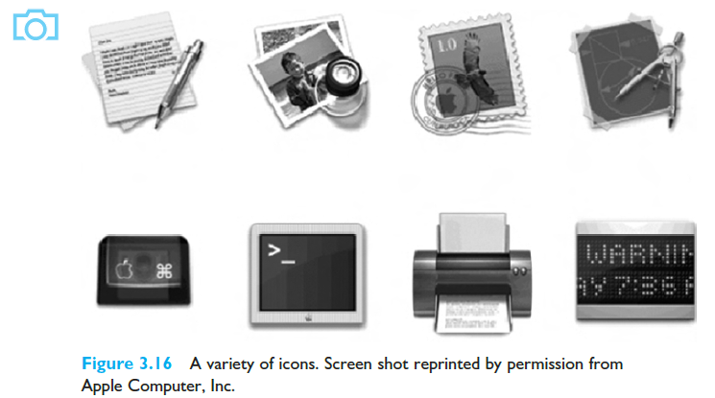
Icons
small picture or image
represents some object in the interface
often a window or action
windows can be closed down (iconised)
small representation for many accessible windows
icons can be many and various
highly stylized
realistic representations.

Slide 48
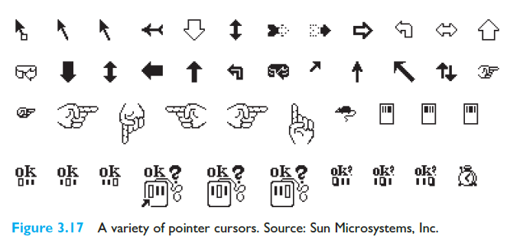
Pointers
important component
WIMP style relies on pointing and selecting things
uses mouse, trackpad, joystick, trackball, cursor keys or keyboard shortcuts
wide variety of graphical images

Slide 49
Menus
Choice of operations or services offered on the screen
In Chapter 1, we pointed out that our ability to recall information is inferior to our ability to recognize it from some visual cue. Menus provide information cues in the form of an ordered list of operations that can be scanned.
This implies that the names used for the commands in the menu should be meaningful and informative.
Required option selected with pointer
problem – take a lot of screen space
solution – pop-up: menu appears when needed

Slide 50
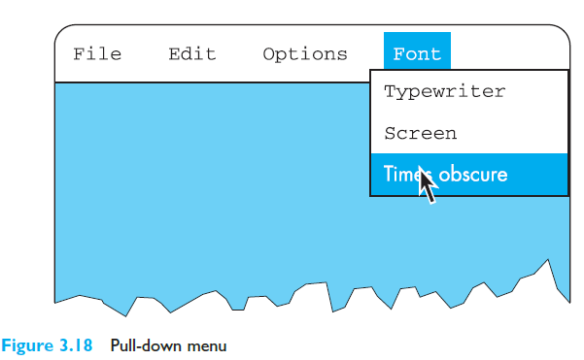
Menus (cont.)
problem – take a lot of screen space
solution – pop-up: menu appears when needed

Slide 51
Kinds of Menus
Menu Bar at top of screen (normally), menu drags down
pull-down menu - mouse hold and drag down menu
drop-down menu - mouse click reveals menu
fall-down menus - mouse just moves over bar!
Contextual menu appears where you are
pop-up menus - actions for selected object
pie menus - arranged in a circle
easier to select item (larger target area)
quicker (same distance to any option) … but not widely used!

Slide 52
Kinds of Menus (cont.)
Figure: Pie Menu

Slide 53

Menus extras
Cascading menus
hierarchical menu structure
menu selection opens new menu
and so in ad infinitum
Keyboard accelerators
key combinations - same effect as menu item
two kinds
active when menu open – usually first letter
active when menu closed – usually Ctrl + letter
usually different !!!

Slide 54
Menus design issues
which kind to use
what to include in menus at all
words to use (action or description)
how to group items
choice of keyboard accelerators

Slide 55
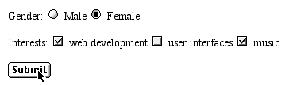
Buttons
individual and isolated regions within a display that can be selected to invoke an action
Special kinds
radio buttons – set of mutually exclusive choices
check boxes – set of non-exclusive choices

Slide 56
Toolbars
long lines of icons … … but what do they do?
fast access to common actions
often customizable:
choose which toolbars to see
choose what options are on it

Slide 57
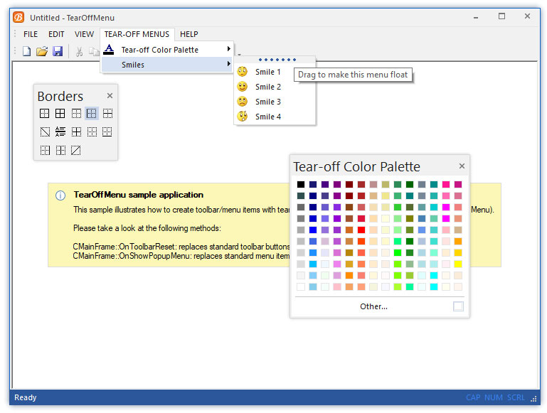
Palettes and tear-off menus
Problem menu not there when you want it
Solution palettes – little windows of actions
shown/hidden via menu option e.g. available shapes in drawing package
tear-off and pin-up menus
menu ‘tears off’ to become palette

Slide 58
Dialogue boxes
information windows that pop up to inform of an important event or request information.
e.g: when saving a file, a dialogue box is displayed to allow the user to specify the filename and location. Once the file is saved, the box disappears.

Slide 59
Interactivity
Easy to focus on look
What about feel?

Slide 60
Speech–driven Interfaces
rapidly improving … … but still inaccurate
how to have robust dialogue? … interaction of course!
e.g. airline reservation: reliable “yes” and “no” + system reflects back its understanding “you want a ticket from New York to Boston?”

Slide 61
Look and … feel
WIMP systems have the same elements: windows, icons., menus, pointers, buttons, etc.
but different window systems … behave differently
e.g. MacOS vs Windows menus
appearance + behaviour = look and feel

Slide 62
Initiative
who has the initiative? old question–answer – computer WIMP interface – user
WIMP exceptions … pre-emptive parts of the interface
modal dialog boxes
come and won’t go away!
good for errors, essential steps
but use with care

Slide 63
Error and repair
can’t always avoid errors … … but we can put them right
make it easy to detect errors … then the user can repair them
hello, this is the Go Faster booking system
what would you like?
(user) I want to fly from New York to London
you want a ticket from New York to Boston
(user) no
sorry, please confirm one at a time
do you want to fly from New York
(user) yes
… … …

Slide 64
Context
Interaction affected by social and organizational context
other people
desire to impress, competition, fear of failure
motivation
fear, allegiance, ambition, self-satisfaction
inadequate systems
cause frustration and lack of motivation

Slide 65
General lesson …
if you want someone to do something …
make it easy for them!
understand their values

